Slide 1
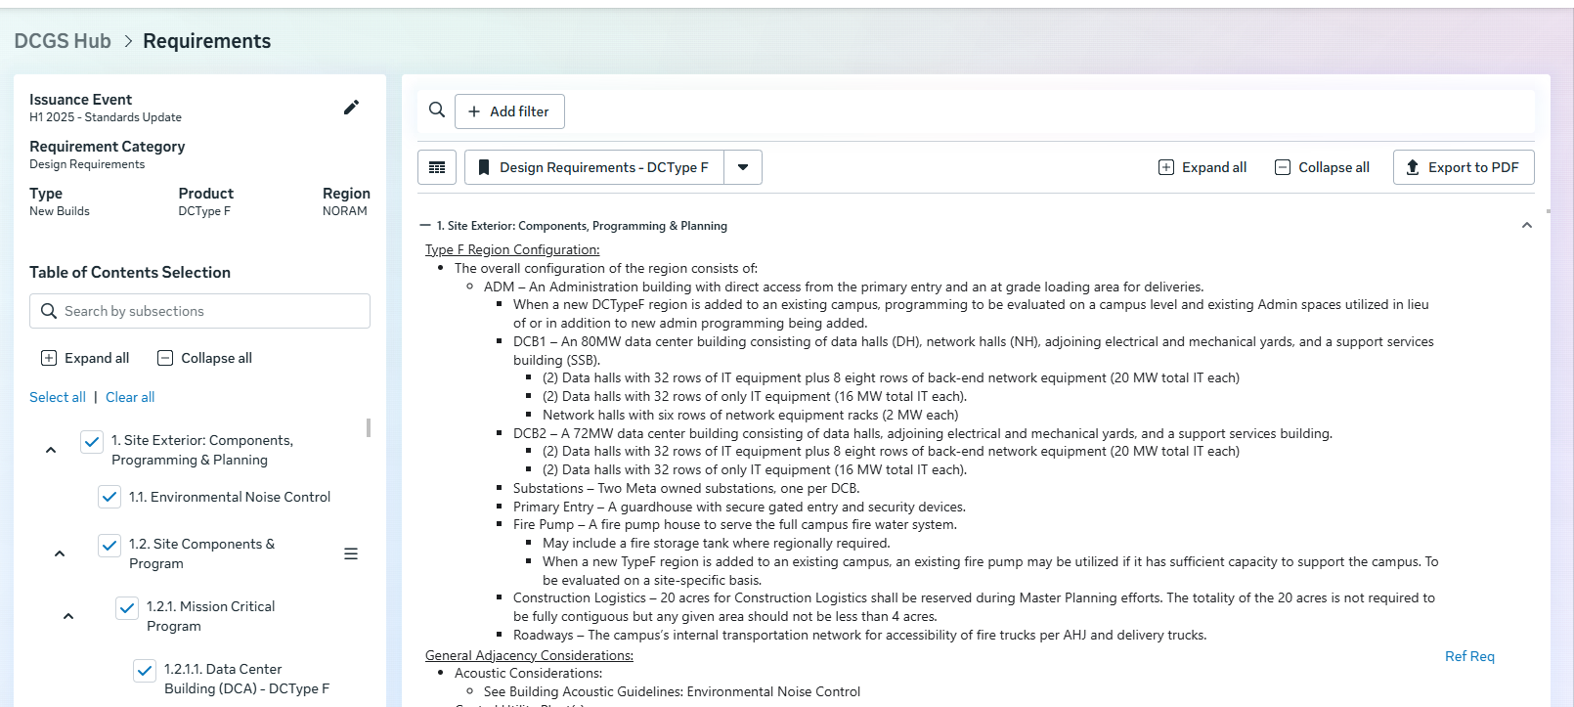
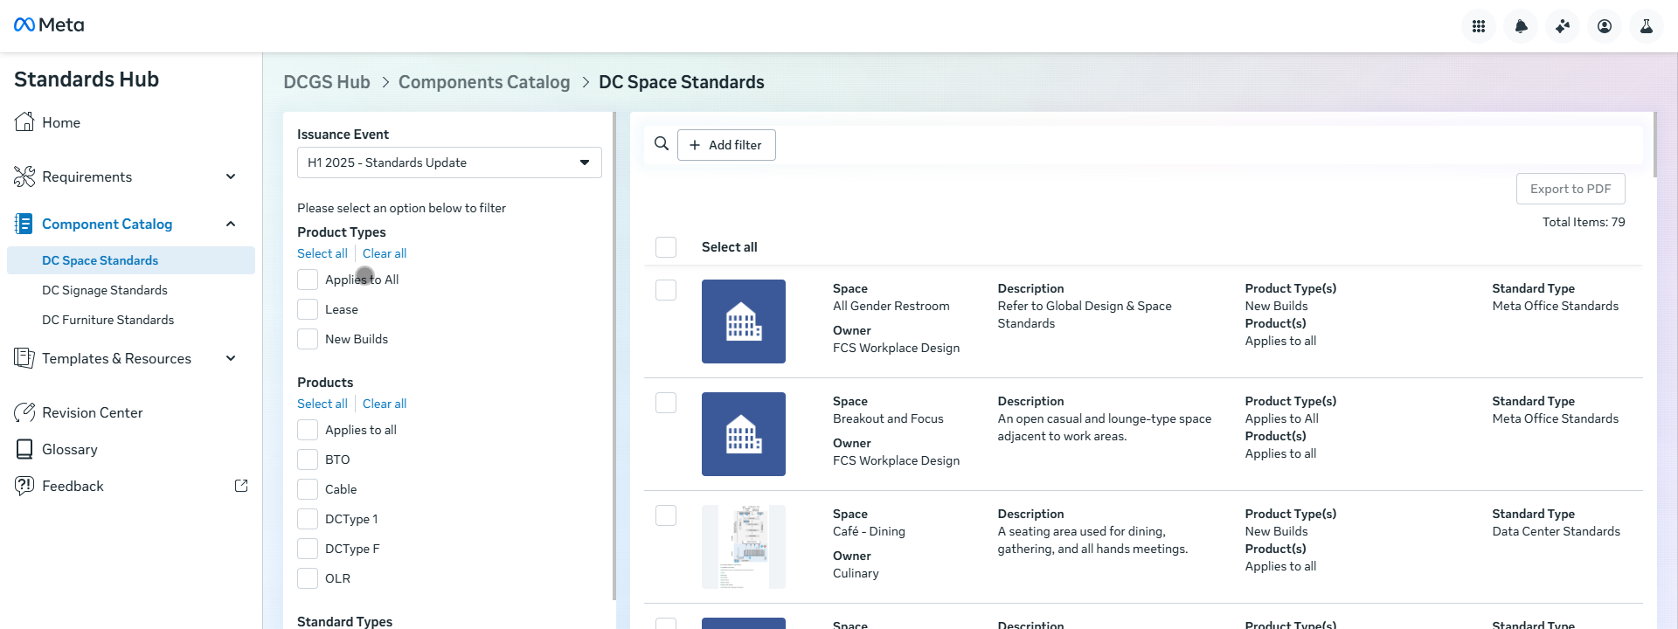
Standards Hub
The Business Need
Meta DEC had a complex SharePoint site for storing, maintaining, and sharing requirements guidelines for data center builds. With shifting technology directives, they required expert assistance with migrating to internal Meta technology.
What We Did
Affirma recommended the technology stack that would best meet requirements, a combination of Intern and Enterprise Center. Visual design was done to create an optimal user experience. Development and data migration was completed resulting in scalable long term platform for the DEC team.
Team Structure
1 full Time Project Manager, 5 Full Time Software Engineers, part time UX/UI, and part time change management
Services & Technology
Intern
Enterprise Center
Email Reminders
React & Ent Development
User Experience & Usability Design
Change Management

Slide 2
DEC AI Integration
The Business Need
Meta DEC had two applications built by Affirma
1 - Storing, maintaining, and sharing requirements guidelines for data center builds
2 – Improve requests for in construction data centers
There was a need to integrate the content of the two systems using generative AI
What We Did
Affirma leveraged Metamate and Metagen to dynamically map improvement requests to existing requirements guidelines. We also added functionality to draft new requirements guidelines based on improvement requests.
Results
The implemented AI integration has resulted in a reduction in manual data entry and content production.
Services & Technology
Intern
Enterprise Center
Email Reminders
React & Ent Development
Metagen
Metamate

